Slide 1

iDNA Assessment Readout
September 12th , 2018

Slide 2
CONTENT
Executive Summary
Approach
Detailed Findings
D Cube Recommendations
Next Steps
Appendix

Slide 3
Executive Summary
The Amgen IS team required a comprehensive assessment of the iDNA platform along the following lines:
  Best Practices capability coverage across platform components
  Component usage and patterns
  Enterprise hardening aspects such as data quality
  Completeness of documentation
Objective
An objective methodology was constructed along with the Amgen team on the basis of workshops and discussions with key stakeholders
The iDNA platform was rated on the following basis
  Data Management (Standardized Data Model Design, Data Isolation and taxonomy, Security, Compression and encryption, Storage and data fabric design)
  Data Pipeline engineering standards and practices
  Infrastructure availability, usage, patterns and alignment with best practices
  Framework design (dynamic airflow, logging)
Approach
We were able to identify key capabilities across the data engineering value chain where opportunities exist for enhancement to meet or exceed industry standards.
The findings across the different pillars have been documented and specific enhancements to the iDNA platform have been called out along with the benefits and value of the enhancements.
Findings & Next Steps

Slide 4
Guiding Tenets: The iDNA platform was assessed against the following high-level dimensions
Framework Design
Data Management
Data Pipeline Engineering
Infrastructure
Standardized Data Model Design
Data Isolation and taxonomy
Security, Compression and encryption
Storage and data fabric design
Standardized Data Model Design
Data Isolation and taxonomy
Security, Compression and encryption
Storage and data fabric design
Data Engineering practices
Performance Engineering standards
Templatized pattern driven pipelines
Pipeline parameters
Pipeline elasticity
AWS Component Usage Assessment
High Availability and Failover
AWS configurations and best practices
Measurement, Monitoring and Logging
Data Management
Framework
Design
Technology Assessment
Infrastructure
Data Pipeline Engineering

Slide 5
FRAMEWORK DESIGN was assessed against the INDUSTRY BENCHMARK per below
1
Enterprise Standards and Rules that are applied into Templates which can be reused
Standards that are applicable to specific patterns of the Data (No One size fits all)
Standardization
Enterprise Hardening
Productivity Gain
Capability Driven
Codeless / Low Code
Configuration Driven & Patten based ingestion.
Low Code touchpoints and Deployment / migration to involve only configuration
5
2
Enterprise Features such as MML Added into the Templates
Security, Data Governance and Data Management embedded into the Patterns followed
Pattern based ingestion, with the parameters to provide inputs.
The implementation of the pattern should be abstracted away from the code.
4
3
For an existing pattern , a productivity of < 1 day to onboard a dataset.
Easy to configure parameters and process in place to do the Ingestion

Slide 6
Data Management, Pipeline Engineering and infrastructure were referenced against industry standard benchmarks per below
1
2
3
4
5
Ingestion
Raw Layer
Transform Layer
Consolidation
Layer
Aggregate /
Data Access
Source Identification
Ingestion
Standardization Template
Raw Data Layer Design
Hash Key & Xref Design
Consolidation Data Layer Design
Aggregate Data Layer Design
Metadata Driven Templates
Database Ingestion Patterns
Raw Data
Merge
Transform Data Libraries (UDF)
Derivation & Calculation Design
Alternate Hierarchy
Xref Design
Pushdown Optimization where possible
Ingestion
History
Incremental Xref Data Load
Define Filter and Column
Transformation
Consolidation Layer Load
Aggregate Load
Data Mapping
Catalog
Xref
Rebuild
Ingestion
Micro Event Batch
Blended Data Load
Dimension Hierarchy Pre Join Load
Ingestion
Incremental
Logic
Transformation
Merge
Ingestion
Real time
Aggregate Publish
Load
Transformation
Tables Definition
Design for Metric Calculation by Hierarchies
6
Foundation Management
S3 Structure
Partition Implementation-
Compression
Design
Info Quality Framework
Orchestration
Integration
User Management
High Availability
Error/Log
Framework
Archival
& Clean up-
Metadata
Management
Pushdown
Data
Continuous Dev
Security Governance

Slide 7
ASSESSMENT APPROACH
Kick off
Assessment Execution
Recommendation
Assessment Plan
Next Steps
Kick off with
the important
stakeholders and start the assessment.
Contribute to iDNA roadmap using the assessment inputs.
Baseline Dimensions and Parameters of Assessment.
Identify critical area in Amgen Landscape which needs to be prioritized higher than others.
Sign off On the Base Line Dimensions and the Parameters for Assessment
Study the Landscape, Interview Critical Stake holders on the following areas.
Process and Governance
Data Architecture
Technology Architecture
Benchmark Amgen Landscape maturity based on the Dimensions and Identify critical areas of Improvement.
Prioritize Assessment Recommendations with Amgen Team
Prepare the Assessment Evaluation Document and Sign off

Slide 8
Summary of findings across categories
Framework Design
Data Management
Productivity gains are hard to achieve with the current FW setup due to metadata & process complexity.
The design does not foster a Codeless or no code paradigm and code base is increased with every additional data source added.
Framework does not cater to several aspects around security, encryption etc.
7 different foundation layers are used and data is persisted across all 7 zones. The functionality can be achieved in lower zones offering same isolation and reducing complexity.
Data Merges happen at the last stage and unmerged data is present in the earlier zones and is not as usable as merged data.
Legend
DETAILS
At par/ above Industry reference
DETAILS
DETAILS
Opportunity for moderate improvements
Data Pipeline Engineering
Infrastructure Management
Dynamic Deployments of Orchestration is breaking the Airflow pipes and multiple deployments happen in a day.
Custom Logging mechanisms are adopted while best of breed components are available
High Availability Mechanisms are not enabled for critical components.
Code base which is not part of Git is leveraged in Jenkins deployments
Opportunity for significant improvements
DETAILS
DETAILS
DETAILS

Slide 9
Detailed Findings:
Framework Design

Slide 10




IDNA PROCESS TOUCHPOINTS TO ONBOARD A SOURCE BASED ON CURRENT FRAMEWORK DESIGN
Framework
Design
50+
2
15
6
Numbers are based on Trial Card & XSUNT load experience
Total Parameters to be replaced
Total of. deployements
Total time per deployeent (mins)
Total of. JSON files
15
20
10
Total no.of SQL codes
Total no. of python files. Of this
Total no. of Dags
2 SQL Codes
5 parameters
3 JSON
1 sub dag
S3
Landing
Source
Organized
Unified
Services Layer
Metrics
Cleansed
Published
2 SQL Codes
5 parameters
3 JSON
1 sub dag
2 SQL Codes
30 parameters
3 JSON
4 sub dags
4 python files
2 SQL Codes
5 parameters
3 JSON
1 sub dag
Legend
20 parameters
3 JSON
10 Python Files
1 sub dag
2 SQL Codes
5 parameters
3 JSON
Significant scope for optimization

Slide 11
Framework
Design
Framework design related Observations (1/2)
Standardization
Enterprise Hardening
Consisent with Industry
The standardization of CDL leveraging multiple zones and configuratoin is available.
Data Quality is performed as part of the Process
Outliers
The Typical Industry Benchmarks to get to stitched data is around 2-3 layers and 2 more layers for the Business KPI Computation.
iDNA has 7 Layers for Data Ingestion and data is promoted to Multiple different Hops
Encryption / Decryption, Key management and Data Security aspects are missing
Merge processing is done as the Last step of the process and till the Merge process the data is basically unusable.
DQ and Integrity checks also increase with number of landing zones.
One Size fit all is followed, certain CDL Columns are added where it is not application , like Dimensional columns get tagged with Time fields etc.
Consisent with Industry
Enterprise aspects around tagging Data Loads to Domains and Sub domains are available.
The unified Models are adopted to bring the data into a standard form
Measurement Monitoring and Logging is handled and a separate Log management data base is there
Epoch Id based tagging / Batch Id based tagging of the Data sets is there.
Outliers
Data tagging on batch Id is there and this tag is carried for 6 layers before it is applied, this is very cumbersome to manage and maintain.
Several Customizations to the Scheduler and Just In Time Deployments to the DAG are adopted to enable Batch Id Tagging on the DAG, the same could have been enabled in Logging.
Custom Logging solution is adopted while Amgen has Kibana and Elastic search capabilities.
Only Process Logs are compiled and System Logs from Airflow / Databricks and other components are not mixed.
Key management based credentials are not there and an environment and Parameter files are used.
Heartbeat processes are handled in Jenkins which does not seem to be highly available and poses challenges on the fidelity of the heartbeats.
Legend
At par/ above Industry reference
Opportunity for moderate improvements
Opportunity for significant improvements

Slide 12
Framework
Design
Framework design related Observations (2/2)
Productivity Gain
Capability Driven
Codeless/Low Code
Consisent with Industry
Configuration Driven Patterns are adopted
Outliers
The Over engineering on the Ingestion and multiple hops leave us with 35+ parameters and 8-9 different Python Code components to be changed for onboarding data.
The effective time to Ingest a data does not pose any significant gains over doing it without a framework.
Consisent with Industry
Enterprise aspects around tagging Data Loads to Domains and Sub domains are available.
The unified Models are adopted to bring the data into a standard form
Measurement Monitoring and Logging is handled and a separate Log management data base is there
Epoch Id based tagging / Batch Id based tagging of the Data sets is there.
Outliers
The Framework is highly tailored to the components chosen, there are not patterns and abstractions available to abstract the component from the capability.
In case Amgen decides to leverage a different tech stack instead of Databricks/Airfow etc, there will be significant re-engineering.
While Templates are available, the patterns are again based on components.
Some of the patterns are non-standard such as the patterns used to execute SQL in the services layer.
Significant level of Component specific customizations around Logging, Orchestration and Execution are there which are embedded into the templates this will lock Amgen into this specific stack.
Consisent with Industry
Enterprise aspects around tagging Data Loads to Domains and Sub domains are available.
The unified Models are adopted to bring the data into a standard form
Measurement Monitoring and Logging is handled and a separate Log management data base is there
Epoch Id based tagging / Batch Id based tagging of the Data sets is there.
Outliers
The Framework required certain code snippets to be altered and code base to be promoted instead of the code being the same and the configurations promoted.
The number of components to be promoted and the components available as JSON, files make it difficult to wrap a UI based screen over the Framework.
Code promotion and creation requires local testing and is hard to replicate a distributed environment.
Legend
At par/ above Industry reference
Opportunity for moderate improvements
Opportunity for significant improvements

Slide 13
Detailed Findings:
Data Management, Pipeline Engineering & Infrastructure

Slide 14


Data Pipeline Engineering
Infrastructure
Data Management
Data Management
Assessment Findings: High Level View
1
2
3
4
5
Ingestion
Raw Layer
Transform Layer
Consolidation
Layer
Aggregate /
Data Access
Source Identification
Ingestion
Standardization Template
Raw Data Layer Design
Hash Key & Xref Design
Consolidation Data Layer Design
Aggregate Data Layer Design
Metadata Driven Templates
Database Ingestion Patterns
Raw Data
Merge
Transform Data Libraries (UDF)
Derivation & Calculation Design
Alternate Hierarchy
Xref Design
Pushdown Optimization where possible
Data Pipeline Engineering
Ingestion
History
Incremental Xref Data Load
Define Filter and Column
Transformation
Consolidation Layer Load
Aggregate Load
Data Mapping
Catalog
Xref
Rebuild
Ingestion
Micro Event Batch
Blended Data Load
Dimension Hierarchy Pre Join Load
Ingestion
Incremental
Logic
Transformation
Merge
Ingestion
Real time
Aggregate Publish
Load
Transformation
Tables Definition
Design for Metric Calculation by Hierarchies
Legend
6
Infrastructure and Data Management
Meets standards
S3 Structure
Partition Implementation-
Compression
Design
Info Quality Framework
Orchestration
Integration
User Management
Does not meet standards
High Availability
Error/Log
Framework
Archival
& Clean up-
Metadata
Management
Pushdown
Data
Continuous Dev
Security Governance

Slide 15
Data Pipeline Engineering
Infrastructure
Data Management
Summary of our findings (1/2)
Data Management
Data Layers
Data Isolation
There are 7 different layers for foundation
This causes excess redundancy and possibility of Data integrity challenges
There are 7 different layers in CDL while the final layer handles the merges.
Most consumption will happen in the 7th layer and the remaining six might not be consumed, this does not cater to the Data Isolation needs
Dynamic Deployment
Just in Time deployments of Code is part of the Airflow execution, this is very non-standard and Airflow refresh of these codes are taking some time resulting in Broken DAG issues.
Epoch ID based tagging with log analysis will perform similar operations
Custom vs Best of Breed
A template (dictionary) is used for storing all the rules, it is cumbersome to maintain.
Scaling and modifying these rules will be difficult
Domain Library based methods are easier to manage
Data Classification
Aspects around Data Security and encryption are not implements.
There are domains such as Customer domain which generally is more sensitive and required specific mechanisms to handle.
Legend
At par/ above Industry reference
Opportunity for moderate improvements
Opportunity for significant improvements

Slide 16
Data Pipeline Engineering
Infrastructure
Data Management
Summary of our findings (2/2)
Data Management
High Availability
Data Engineering
Airflow uses Celery mode with 2 executers
No High Availability was observed
EKS/ECS can be implemented
Partitioning is done only based on batch id and date fields. Review of Data distribution is needed
Gzip compression is used. Compression techniques should ideally depend on the need, i.e, space or performance optimization. But the same method has been used everywhere
Process and Standard
JSON is used for storing metadata and DQ rules which is difficult to manage.
An excel based template is used for adding new rules which can lead to integrity challenges.
Archival for intermediate layers is not present
Hard coding is done while performing column rename operations. This has to be parametrized
Metrics Engine
A template (dictionary) is used for storing all the rules, it is cumbersome to maintain.
Scaling and modifying these rules difficult
Domain Library based methods are easier to manage
Pipeline Optimization
Cluster Spin up and spin down is not optimized as it occurs often
Broken dag issue is very frequent as batch id is dynamically attached to airlflow dag
Security & Governance
Security passwords are clear text
Key Management Systems are not Used
User Management is not strong , every one has Sudo access.
Legend
At par/ above Industry reference
Opportunity for moderate improvements
Opportunity for significant improvements

Slide 17
Enhancement Opportunities & Next Steps

Slide 18
Recommended ENHACEMENTS to iDNA: Priorities for next 120 days
Process and Standard
High Availability
Metrics Engine
1
Reduce Ingestion Complexity – parameter Automation and Abstraction Layer
Enable High Availability
2
3
Feature Libraries by Data Domains
This will reduce the effort needed for configuring the input parameters
Errors can be easily identified in the configuration before even running the flow
This will help to bridge the gap in current failover management (none implemented)
The end user need not worry about how the business rules/joins have to be implemented
Pre configured joins etc will be available
Data Isolation
Data Classification
Dynamic Deployment
4
Ingestion Patterns for different Data Domains.
Key management Mechanism
Framework Improvements
5
6
Since only one type of flow is present for all data sources, there could be a lot of redundant steps
Multiple flows based on complexity could reduce these redundant steps
Will make the security system more robust by encrypting the passwords etc.
Best of breed logging can be leveraged
Broken dags issue can be resolved

Slide 19
Recommended ENHACEMENTS: Effort vs Value Grid
5
1
Reduce Ingestion Complexity – parameter Automation and Abstraction Layer.
3
6
1
High
2
Enable High Availability
3
Feature Libraries by Data Domains
4
Ingestion Patterns for different Data Domains.
Value
2
Med
Key Management Mechanisms
5
4
Framework Improvements
- Logging using Elastic search/Kibana
- Remove JIT deployments (dynamic airflow)
- Cluster Spin Optimizations
- Data Domain specific Patterns
- Reduce One size fits all paradigms
6
Low
Low
Medium
High
Ease of Enablement (1/Effort)

Slide 20
Approach/ Examples

Slide 21
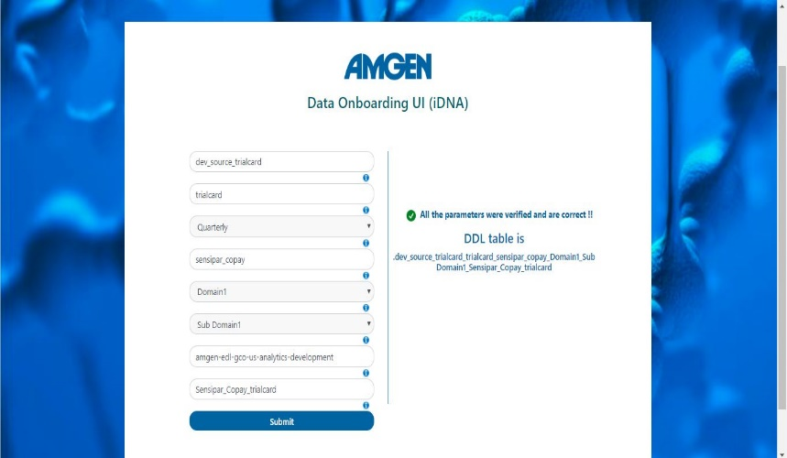
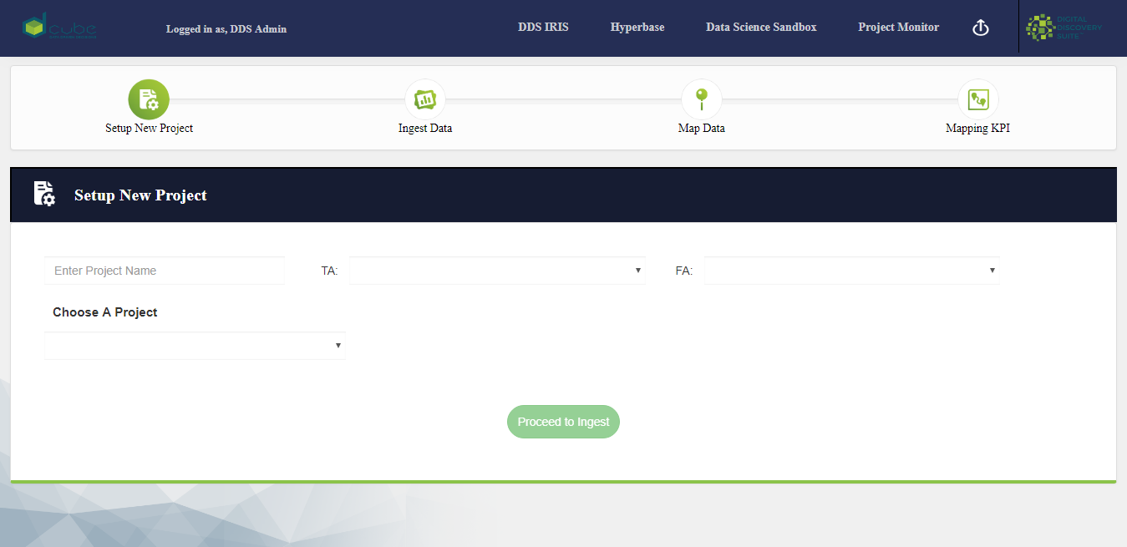
Identified ENHACEMENTS to IDNA: framework improvement
Reduce Ingestion Complexity – parameter Automation and Abstraction Layer.
D Cube has prior experience in building an UI based ingestion platform. This eases the process of generating the parameters needed automatically rather than manually entering every parameter, as currently practiced on the iDNA, which makes tracking these parameters really difficult. Thus, to reduce the complexity, an UI can be built on top of the existing framework.

Slide 22
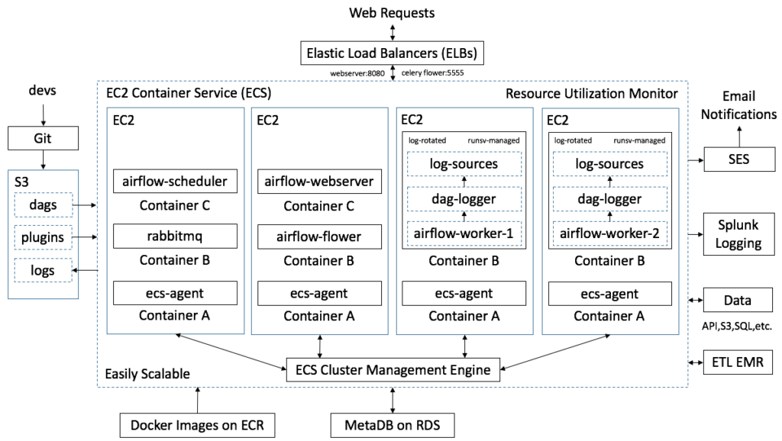
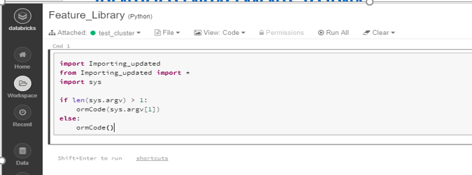
Identified ENHACEMENTS to IDNA: High Availability & Feature Libraries
High Availability reference architecture
Feature Libraries by data domain
Raw data
Standard Model
Feature Library
A typical feature library will contain functions to join various data tables, rules for consolidation, aggregations etc. This will be built on top of unified data. The end user can import the necessary modules and functions without worrying about the data source or SQL etc to be used. D Cube has built an exhaustive list of libraries to calculate various KPIs from different domains for most of the vendors
D Cube has prior experience in High availability services which has been implemented in our own platform. Hence, it would be easy to implement this on iDNA

Slide 23
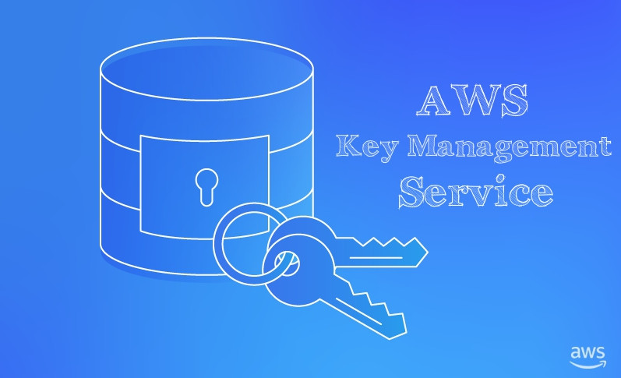
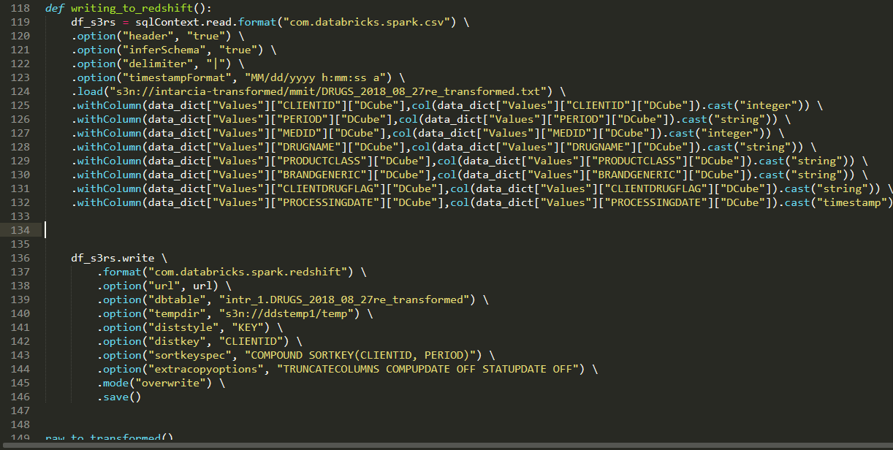
Identified ENHACEMENTS to IDNA: ingestion pattern based on data domain and key management system
Ingestion Pattern of Different Data Sources
Key Management Mechanism
Complex cleansing and unification
Oncology data
Raw data
Raw data
Final Data
Simple cleansing and unification
Prescriber data
Raw data
Final Data
Currently, on the iDNA platform, no Key Management Service has been implemented, resulting in passwords not being encrypted and exposed to all. D Cube has experience in leveraging the native AWS Key Management system which we can seamlessly implement on the iDNA platform making the security system more robust
D Cube has prior experience in creating extractors to standardize data belonging to different sources (ranging from low to high complexity). These extractors can be leveraged to subjectively standardize different data sources, rather than having a single template for all types of data

Slide 24
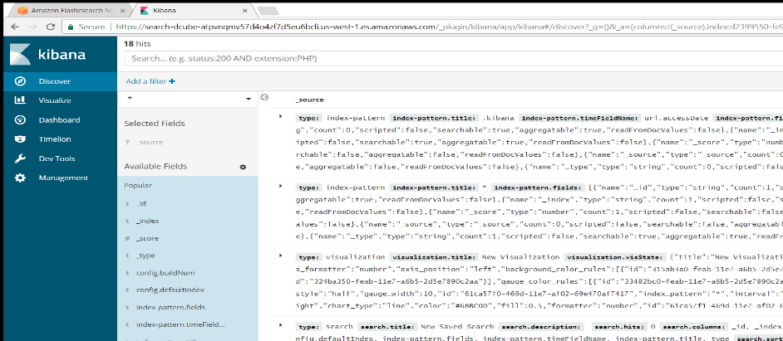
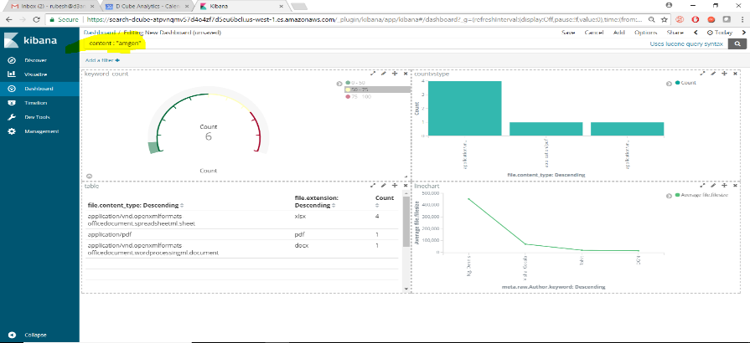
Identified ENHACEMENTS to IDNA: framework improvement
Best of Breed Logging

Slide 25
Timeline & Next Steps

Slide 26
Immediate term Implementation PLAN
Description | First 30 Days | 90-120 Days (2-week Sprints) | Continued Implementation
Align on Outcomes and Priorities
High Value Enhancements
Continuous Improvement
iDNA Team setup & ramp up
Enable High Availability
Key Management & Security
Simplify Data Onboarding and Enable Self Service Onboarding of Data
Enable Domain Specific Data Libraries
Framework Improvements
Pattern Based Ingestion
SUPPORTED BY D CUBE DATA SCIENCE & ENGINEERING COE
Legend
Immediate priority
Medium priority
Lower Priority
Notes:
Thought:
BPOs are so last decade – do not use the word BPO
Make sure questions are answered

Slide 27
NEXT STEPS
Align on priorities with respect to enhancements in view of the strategic road map for iDNA and other emerging business requirements
Collaborate on an integrated project delivery plan
  Identify team structure & profiles to implement plan
  Define approach and delivery methodology
  Generate timelines and effort estimates
Finalize plan and kick off

Slide 28
Appendix

Slide 30

Ingestion

Slide 31
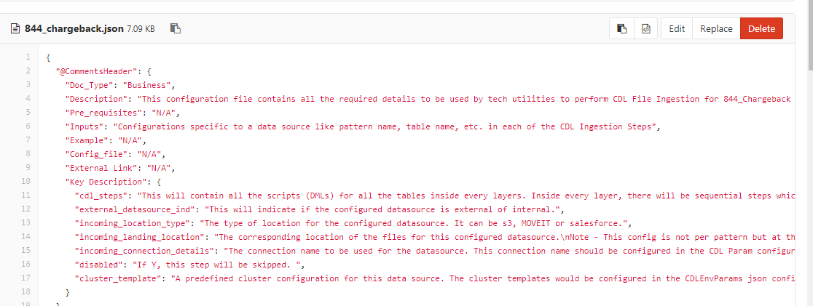
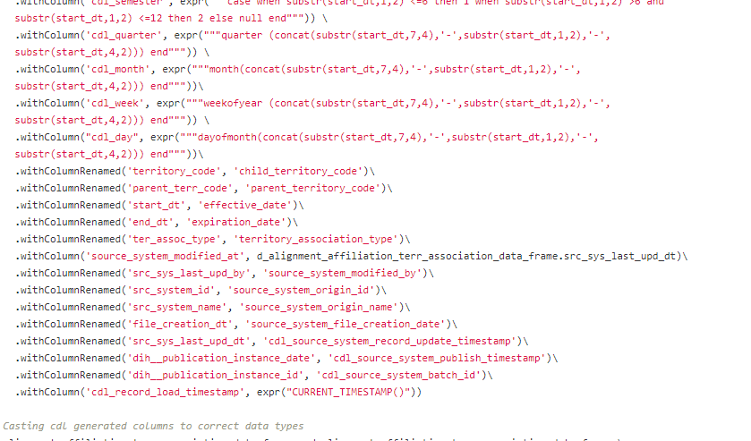
INGESTION
Go Back
Metadata Driven Templates
Database Ingestion Patterns
Existing Method & Observations
Pattern based ingestion is followed which is a standard operation
A standard structure library was not found
Alation could be potentially leveraged for creating a standard structure library for all tables
Ingestion incremental logic and Micro batch event was not observed

Slide 32
Data Loading

Slide 33
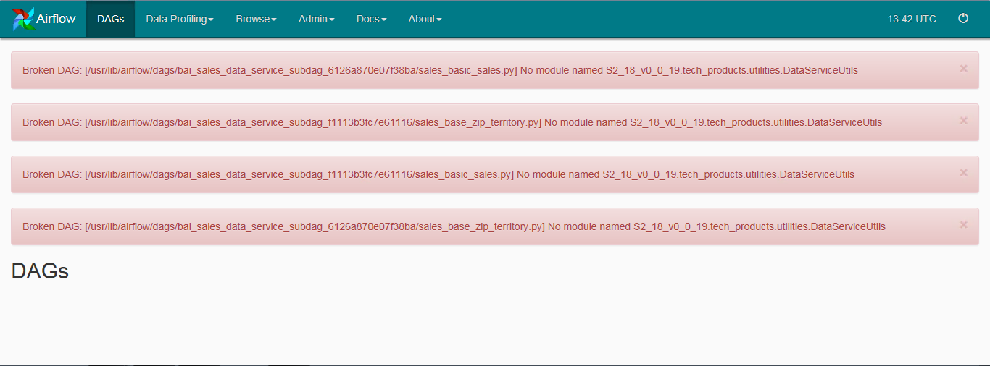
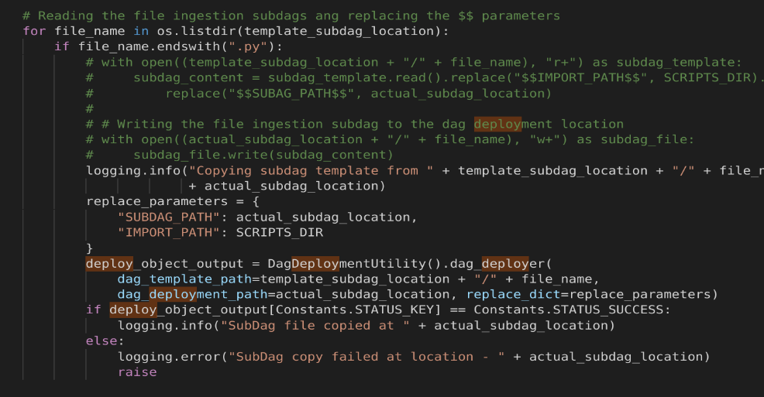
Go Back
Findings from data loading: just in time deployment
DAG ISSUES
Dags are dynamically created and placed in the dag folder with batch id
Trigger of this dag happens after this dag is located in the folder
Due to syncing issues, trigger may fail to happen sometimes

Slide 34
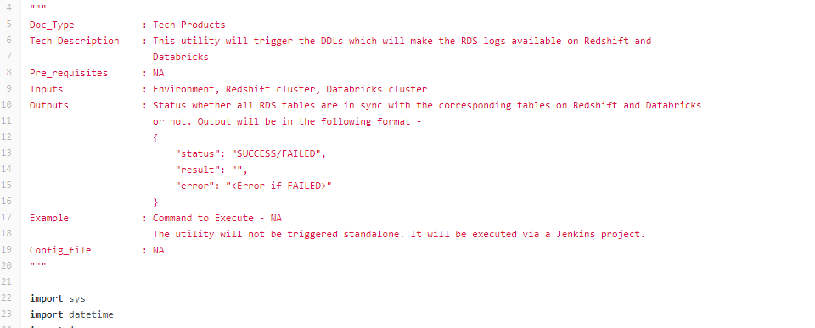
Go Back
Findings from data loading: built from scratch solution vs industry standards
Logging
Custom logging solution is built.
Native AWS Solutions such as Elastic Search and Kibana would have saved a lot of time and offered more robust capabilities
Changes to log capture and attribution requires extensive code changes

Slide 35
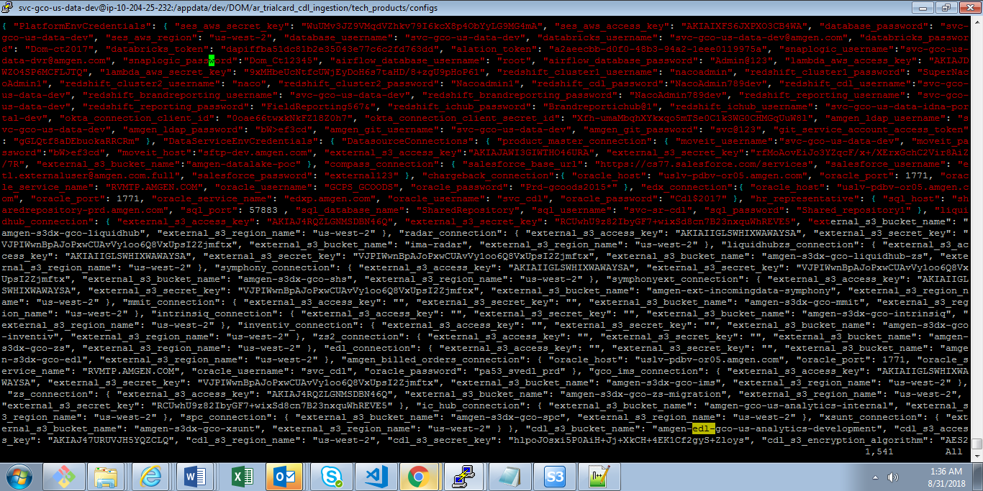
Go Back
Findings from data loading: SECURITY
Security Issues
The folder containing secret keys and passwords are not encrypted
The Connections details of all the users are exposed
Security standards not adhered

Slide 36
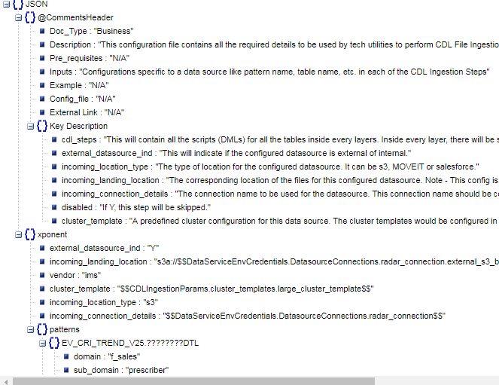
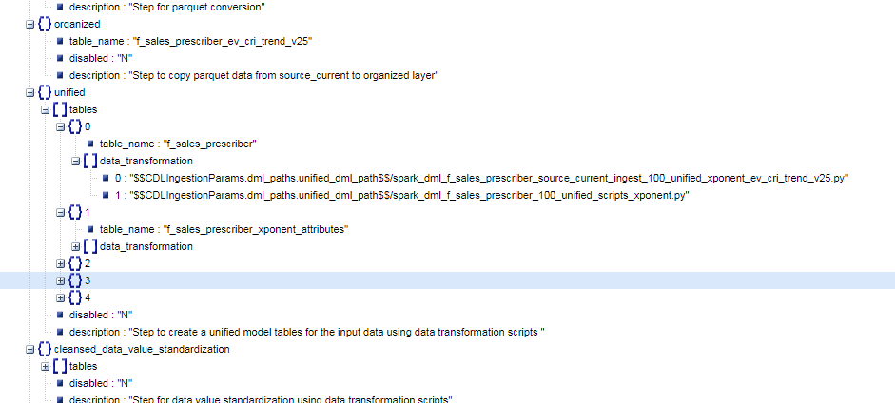
Go Back
Findings from data loading: Complexity due to multiple parameters
Too many parameters and layers
There are about 70 parameters which needs to be configured for every load
These parameters are present across almost every step of the process
This makes the process error prone

Slide 37
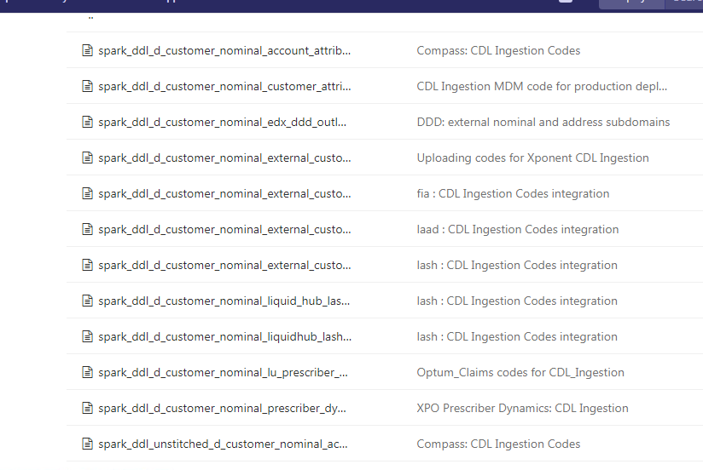
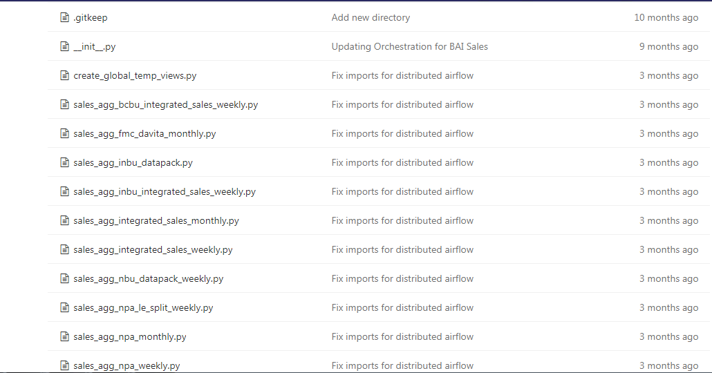
Go Back
Findings from data loading: ddl and sql implementation
Complex DDL and sql Implementation
Starting from organized layer, databricks tables have to be created before hand
Creating the various tables at each layer manually adds to the complexity
A separate Jenkins process is implemented for creation of this
Heavy python wrappers for executing Sqls

Slide 38
INFRASTRUCTURE

Slide 39
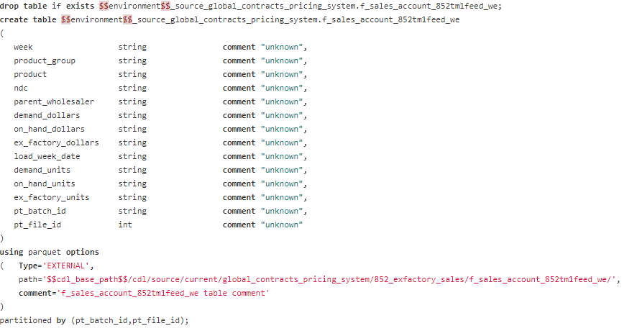
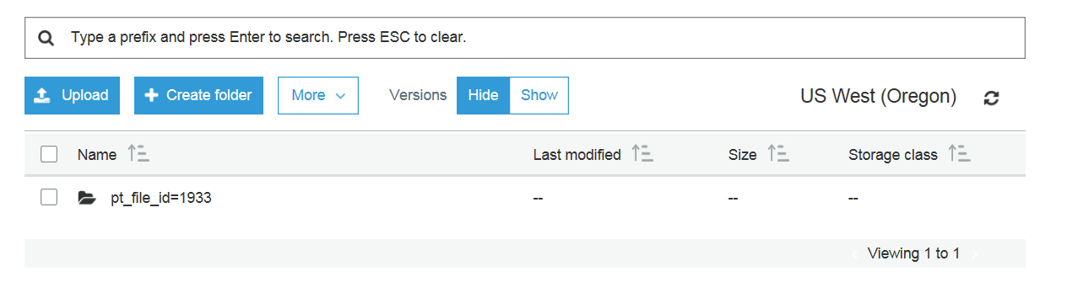
INFRASTRUCTURE COMPONENTS:PARTITIONING
Go Back
S3 Structure
Partition Implementation
Existing Method & Observations
Partition done only on batch id and file id
Most of the batch ids have only one file id partition
May not be very effective as it lacks subjective partitioning
Query performance will suffer with increase in level of partitions and in many cases we find one to one mapping between the multiple levels

Slide 40
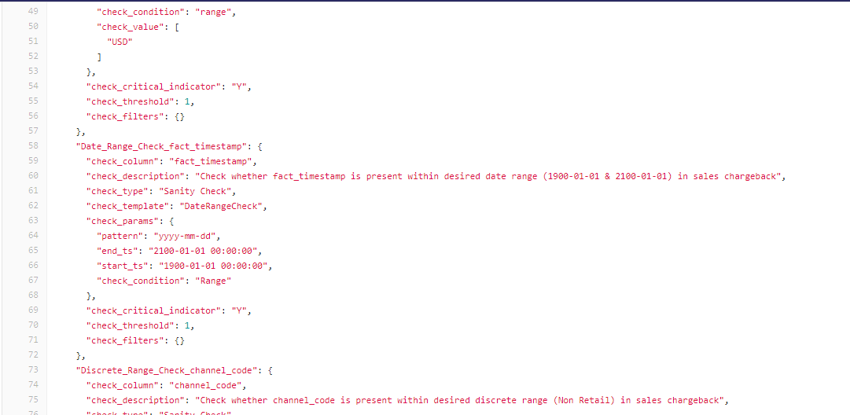
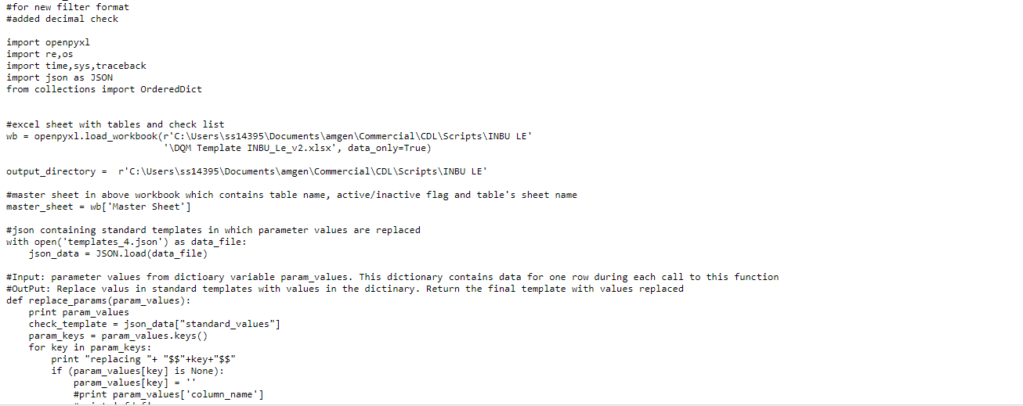
INFRASTRUCTURE COMPONENTS:DATA QUALITY MANAGEMENT
Go Back
Info Quality Framework
Existing Method & Observations
Syntax and Data quality checks exist between different layers
A JSON file with specific rules for different data sources
An excel based template is used as the source for these rules
Maintaining and modifying these rules will be open to errors due to lack of security in using excel based templates

Slide 41
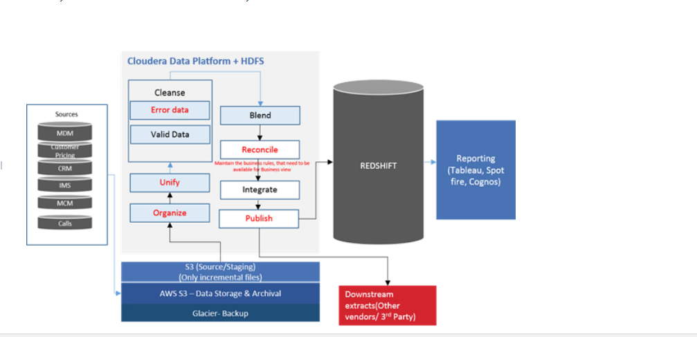
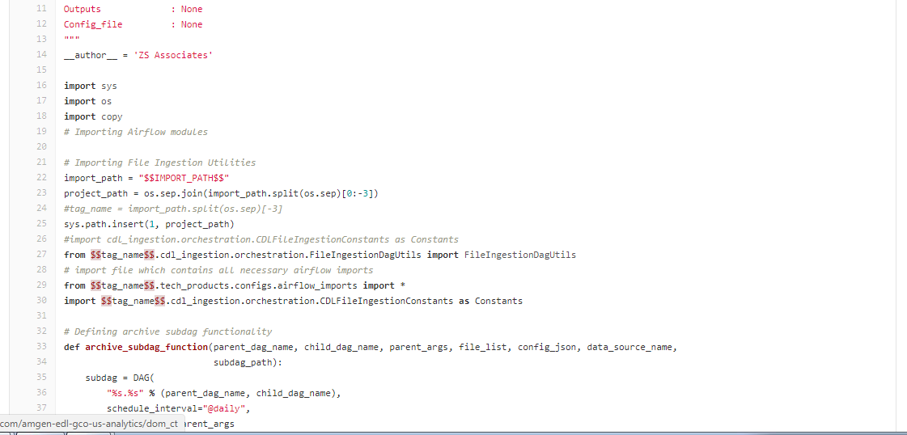
INFRASTRUCTURE COMPONENTS: ARCHIVAL
Go Back
Archival
& Clean up
Existing Method & Observations
Data at staging layer is being archived
The publish and integrate layers are business critical and if there a load issue or dag issue, it may impact the business usage. Archival at these layers are not present

Slide 42
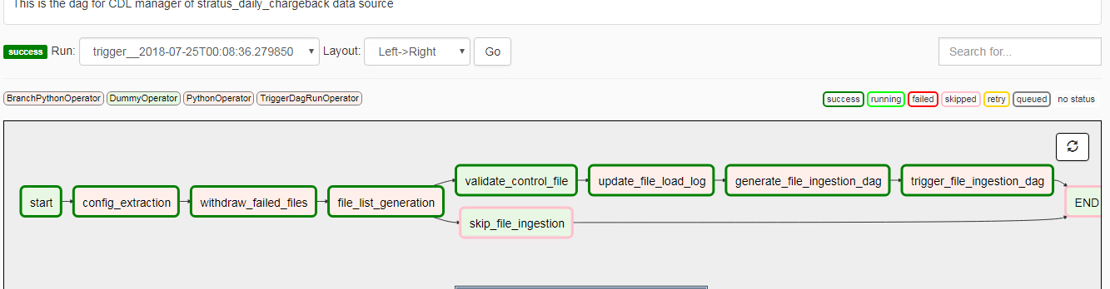
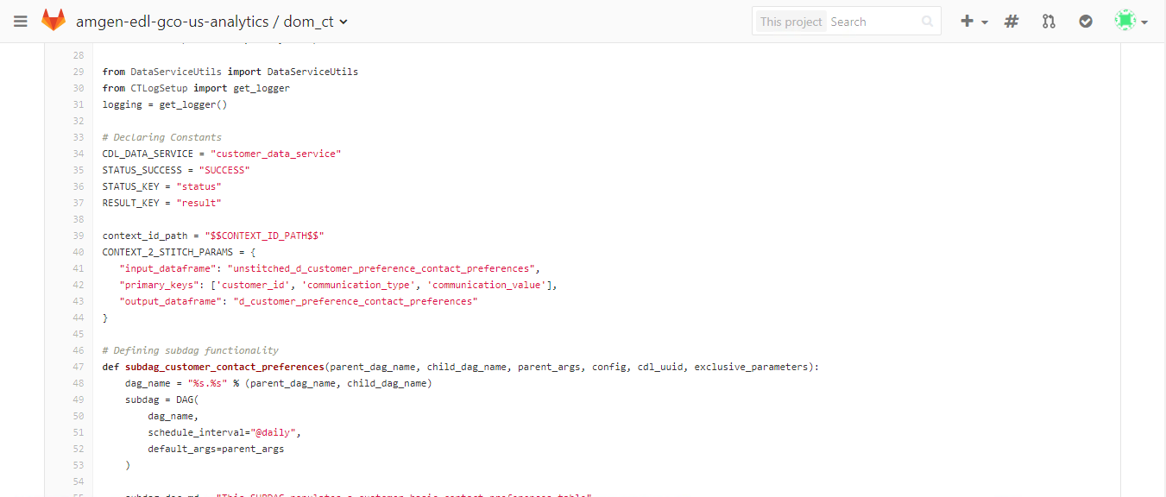
INFRASTRUCTURE COMPONENTS:ORCHESTRATION
Go Back
Orchestration
Integration
Existing Method & Observations
Dag and Sub dag templates exist for CDL and Services
Multiple operators like branch, trigger, subdag operators are used
Broken dags error seem to occur very often, this is because dags are dynamically assigned batch id and deployed. This is a non standard orchestration procedure
Dag and ETL logic are tightly linked making it difficult to move to a different orchestrator is needed.

Slide 43
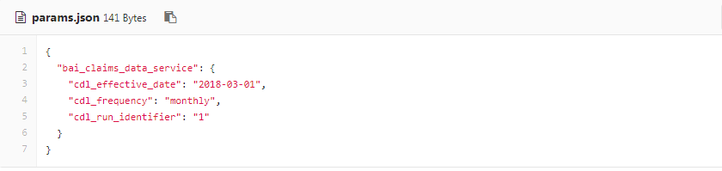
INFRASTRUCTURE COMPONENTS: METADATA MANAGEMENT
Go Back
Metadata
Management
Existing Method & Observations
JSON files are used
Maintaining and Modification is difficult
NoSQL based metadata management would be more robust and manageable compared to having parameters in the file

Slide 44
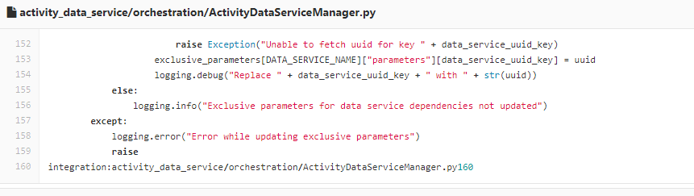
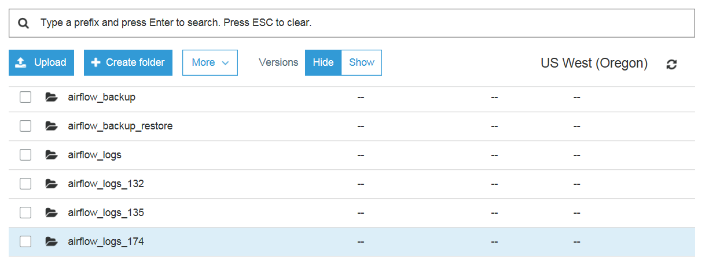
INFRASTRUCTURE COMPONENTS: LOGGING
Go Back
Error/Log
Framework
Existing Method & Observations
3 types of logging: Airflow log, databricks log for spark jobs

Slide 45
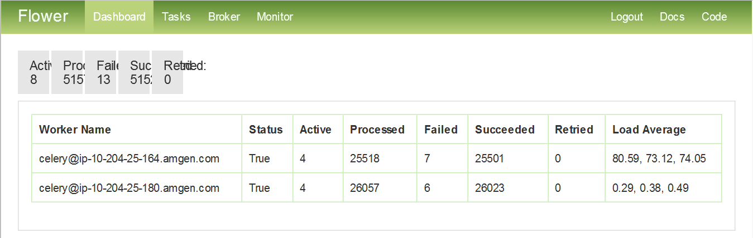
INFRASTRUCTURE COMPONENTS: HIGH AVAILABILITY
Go Back
High Availability
Existing Method & Observations
No high availability service was observed
Celery executor is used in orchestration with 2 workers
Containerization has not been implemented

Slide 46
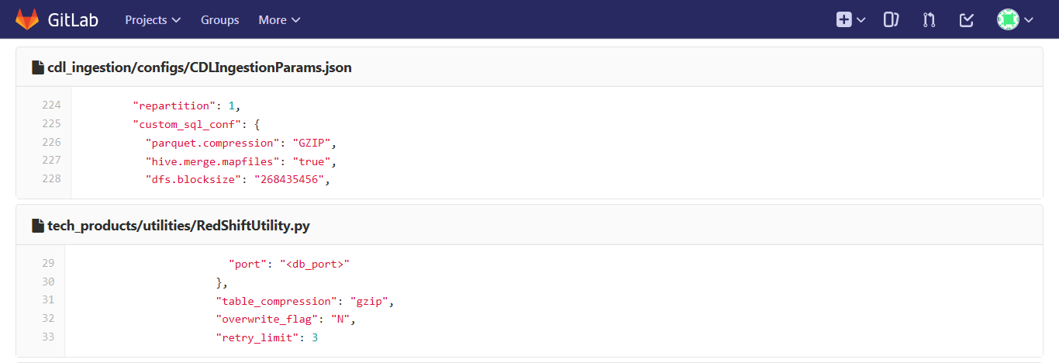
INFRASTRUCTURE COMPONENTS: COMPRESSION TECHNIQUES
Go Back
Compression
Existing Method & Observations
Gzip compression is used
Compression techniques should ideally depend on the need, i.e, space or performance optimization. But the same method has been used everywhere

Slide 47
INFRASTRUCTURE COMPONENTS: SECURITY
Go Back
Existing Method & Observations
No key management system implemented

Slide 48
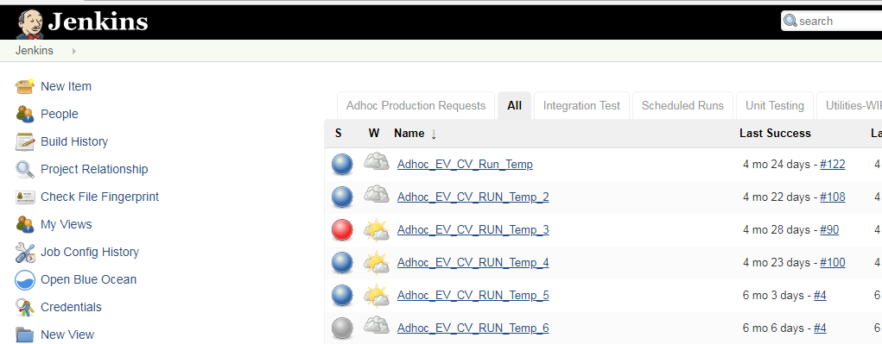
INFRASTRUCTURE COMPONENTS: CI/CD
Go Back
Continuous Dev
Existing Method & Observations
Resonates with industry standards

Slide 49
RAW LAYER

Slide 50
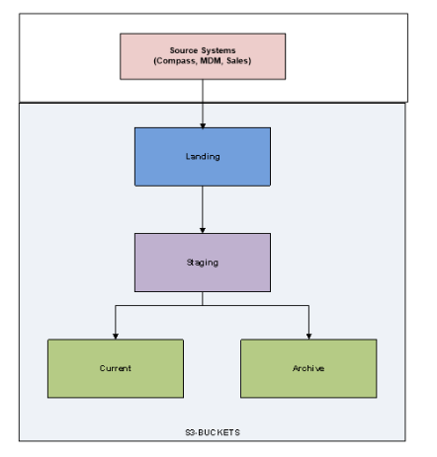
RAW LAYER
Go Back
Raw Data Layer Design
Define Filter and Column
Transformation
Existing Method & Observations
Landing, Staging and Current layer are present
Landing and Staging Layer are partitioned by time period (year, month)
Source and destination column names are hard coded while renaming which is not optimal
Methods for raw data merge was not observed

Slide 51
TRANSFORMATION LAYER

Slide 52
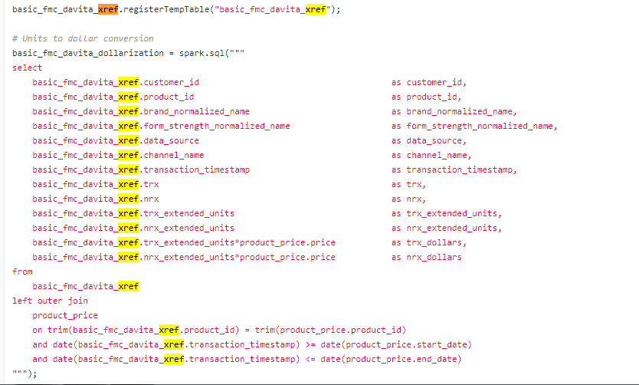
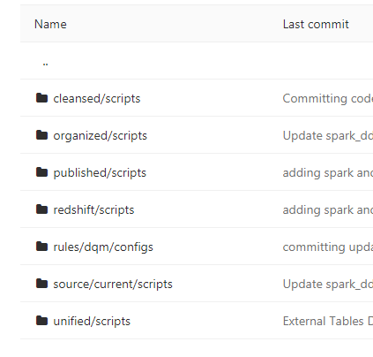
TRANSFORMATION
Go Back
Hash Key & Xref Design
Transformation
Tables Definition
Existing Method & Observations
Unified, Cleansed layer are present during transformation
Colum names hard-coded while renaming which is not optimal
DDL commands for creating these tables have created prior starting the ingestion process
Cross refence tables are used

Slide 53
CONSOLIDATION LAYER

Slide 54
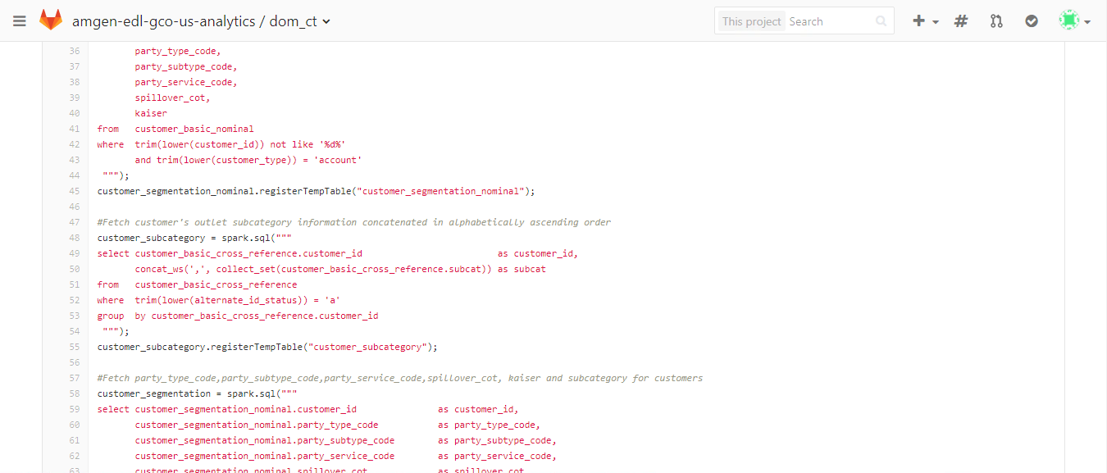
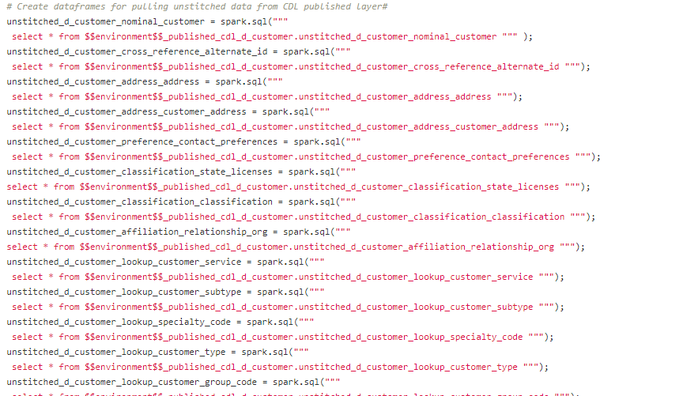
CONSOLIDATION AND AGGREGATION
Go Back
Consolidation Data Layer Design
Aggregate Data Layer Design
Blended Data Load
Design for Metric Calculation by Hierarchies
Existing Method & Observations
SQL Codes are used for performing merging and aggregation
Maintaining and modifying SQL codes is complicated
An ORM based rule engine can be used in place of direct SQL codes
Complex orchestration in Airflow

Slide 55
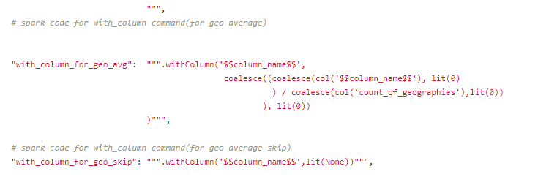
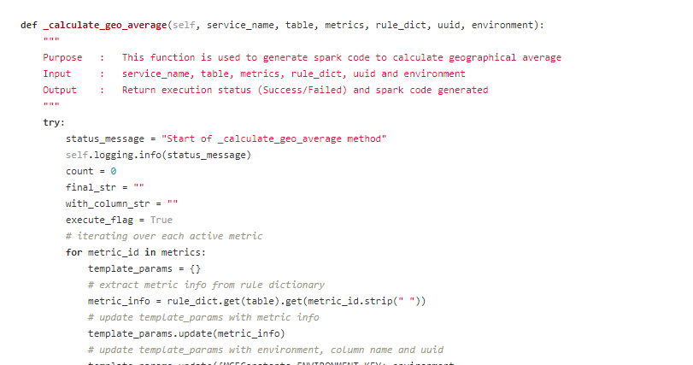
METRIC ENGINE
Go Back
Existing Method & Observations
A template (dictionary) is used for storing all the rules
Scaling and modifying these rules difficult
ORM based rule engine can be used in spark sql

Slide 56
Thank You

